Slide 1
MLDS HW3-3
TAs
ntu.mldsta@gmail.com

Slide 2
Outline
Timeline
Model
Result
Submission & Rules
Q&A

Slide 3
Timeline

Slide 4
Three Parts in HW3
(3-1) Image Generation
(3-2) Text-to-Image Generation
(3-3) Style Transfer (Bonus)

Slide 5
Schedule
5/4 :
Release HW3-1
5/11 :
Release HW3-2
5/18:
Release HW3-3
6/8:
All HW3 due (including HW3-1, HW3-2, HW3-3)
上台分享

Slide 6
Task Descriptions

Slide 7
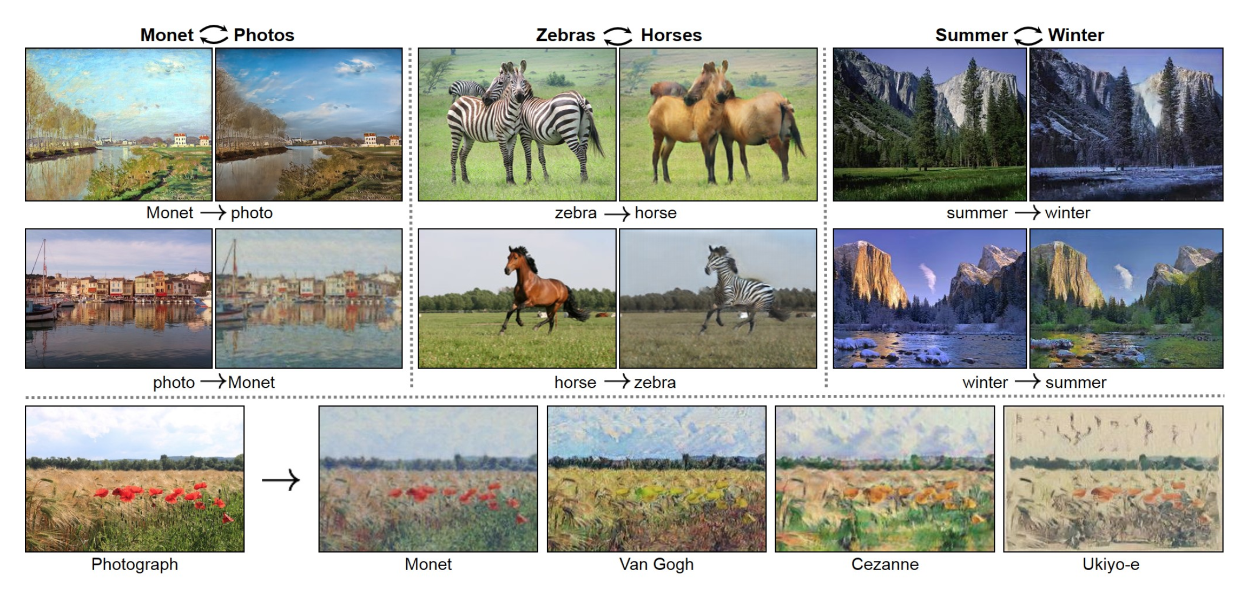
HW3-3: Style Transfer
Ref:https://arxiv.org/pdf/1703.10593.pdf

Slide 8
Model

Slide 9
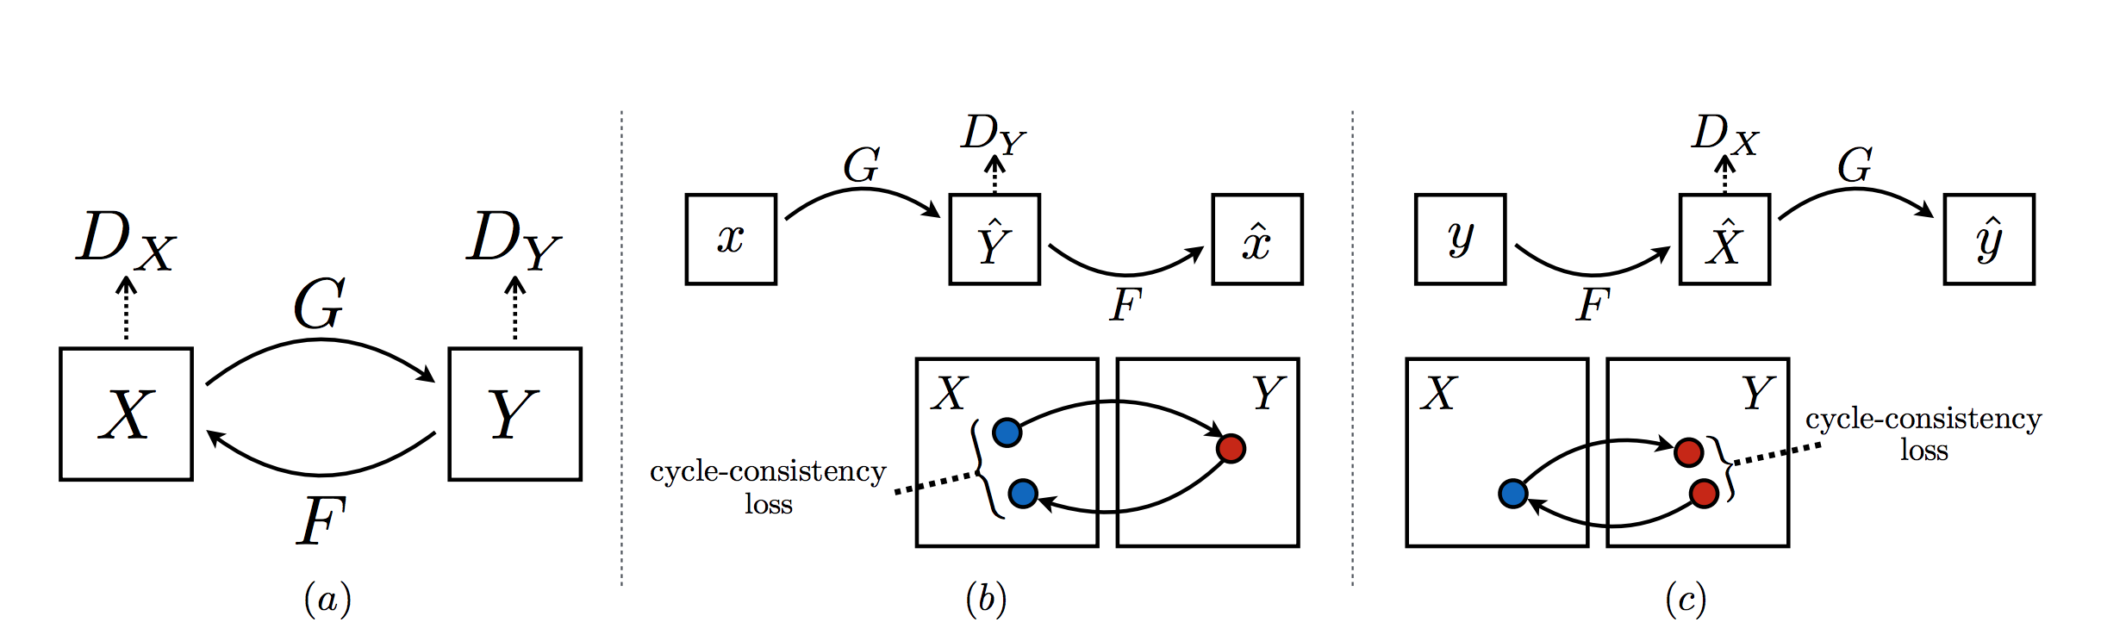
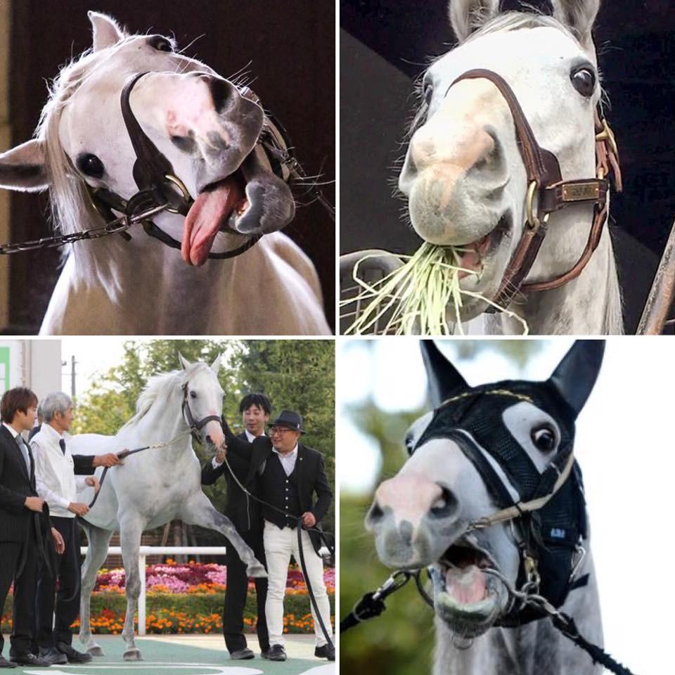
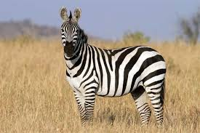
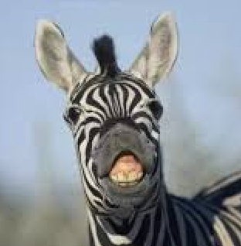
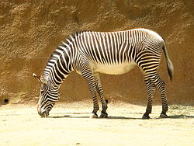
Cycle GAN
Train X to Y
Train Y to X

Slide 10
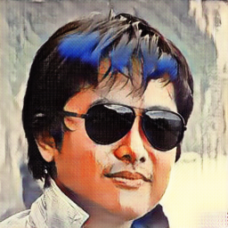
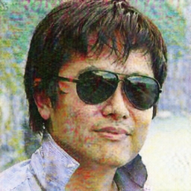
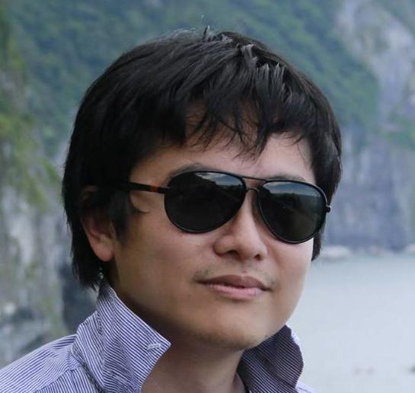
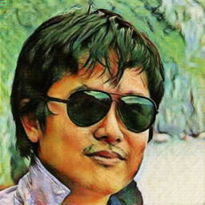
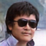
Cycle GAN Result
浮世繪教授
莫內教授
梵谷教授
動漫教授

Slide 11
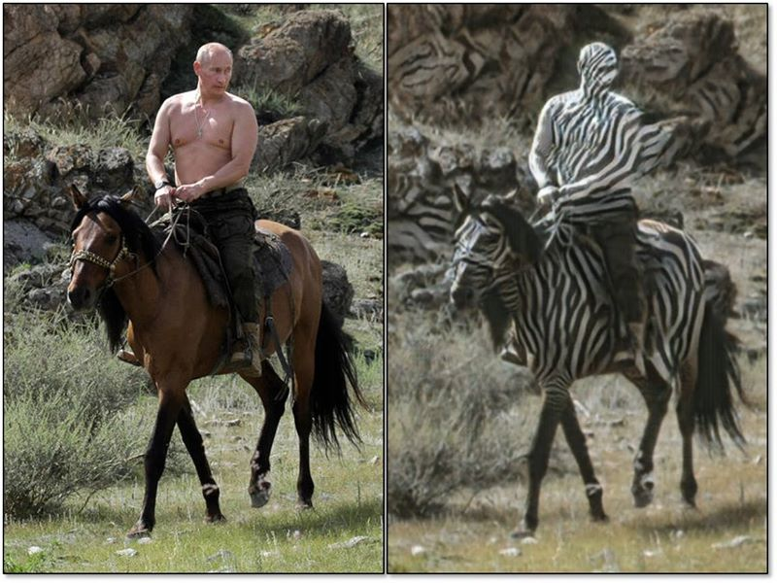
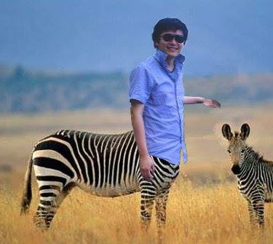
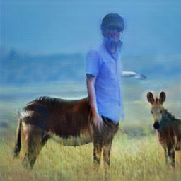
Cycle GAN Result - zebra2horse

Slide 12
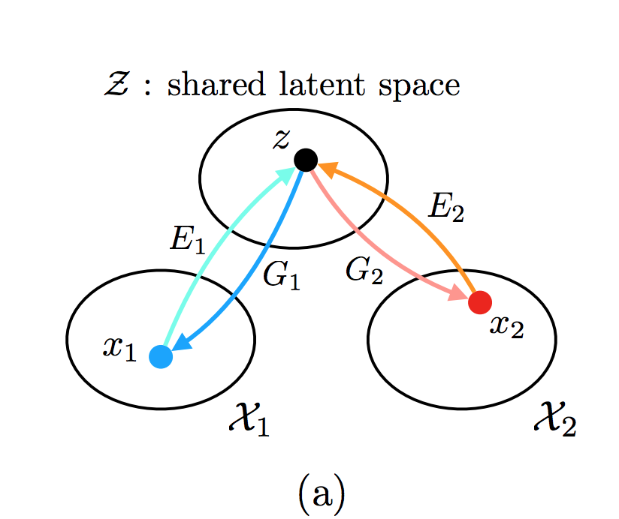
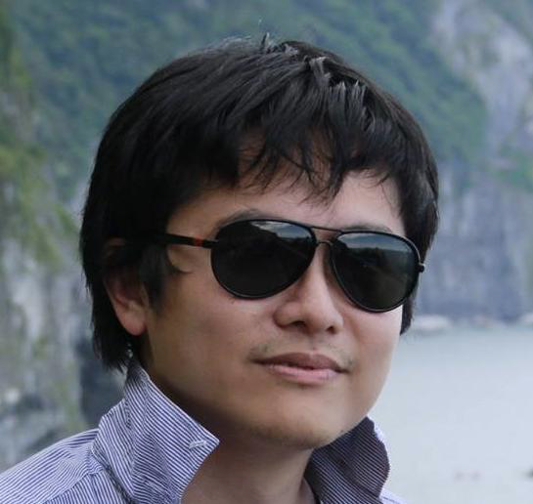
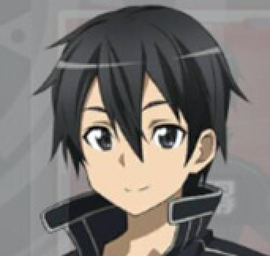
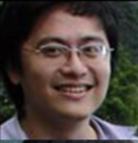

UNIT

Slide 13
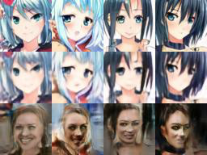
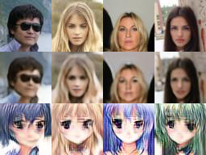
UNIT Result
Anime2Real
Real2Anime

Slide 14
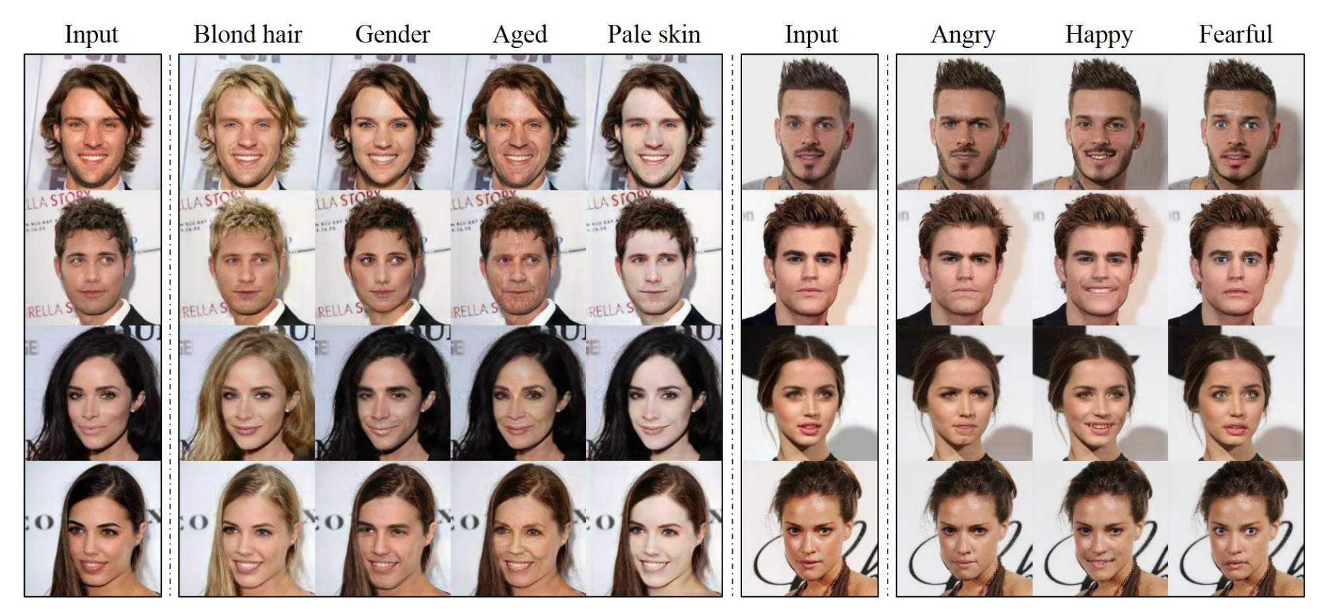
StarGAN
Ref: https://arxiv.org/pdf/1711.09020.pdf

Slide 15
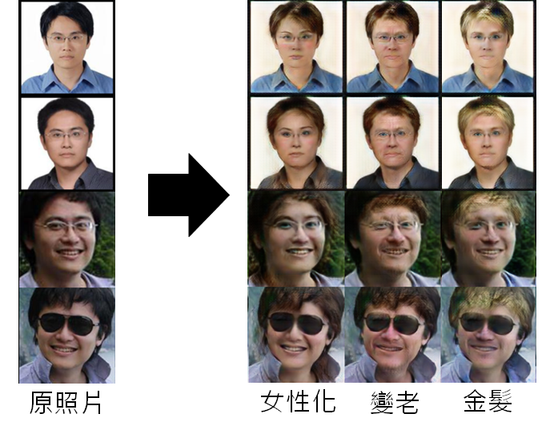
圖片生成：
吳元魁
Photo: Hung-Yi Lee

Slide 16
Some Reference
Code
CycleGAN: PyTorch (original), Tensorflow
StarGAN: PyTorch (original), Tensorflow
UNIT: PyTorch (original), Tensorflow
Dataset
CelebA
Other Model
DiscoGAN
DualGAN

Slide 17
Submission & Grading

Slide 18
HW3 Grading Policy:
HW3-1 Code (image generation) : 5%
HW3-2 Code (text-to-image generation): 5%
Report : 15% (+2%)
HW3-3 (Bonus, style transfer): 2%
分工表：0.5%
上台分享 : 1%
上台分享前三名：1%

Slide 19
HW3 Report Questions
Model Description
Experiment settings and observation
Experiment: changing parameter…, data augmentation
You can use wgan, wgan-gp, lsgan in this section
Comparison between gan and wgan, wgan-gp, lsgan should move to the next section
Compare your model with WGAN, WGAN-GP, LSGAN (choose 1) (Image Generation Only)
Training tips for improvement (Image generation Only)
Style Transfer (2%)

Slide 20
HW3-3 Report Grading
Show your result (1%)
Two domain and transfer result
Analysis (1%)
Which model you use and your observation
Any Dataset(Style) is allowed
Any Model is allowed
Only inference is allowed

Slide 21
Submission
Deadline: 2018/06/08 GMT+8 24:00
hw3/ should contain the following files:
run_gan.sh (hw3-1)
run_cgan.sh (hw3-2)
extra_run.sh (hw3-3, bonus) (Move into report)
samples/, samples/gan_original.png, samples/cgan_original.png
report.pdf
pre-trained model, python code...
If some files are too big, upload to your cloud and download them when running your run.sh
紅字表示必要，且名稱不得更改，其餘不限制
TAs will run your scripts in the following order to generate images
bash run_gan.sh (hw3-1)
bash run_cgan.sh <testing_tags.txt> (hw3-2)
All scripts must output in 10 minutes.
shell script裡面請寫相對路徑
遲交沒有分開計算

Slide 22
Q&A
ntu.mldsta@gmail.com

